Slide 1
Emails From Profs
by Marc-Olivier Roch Lalonde

Slide 2
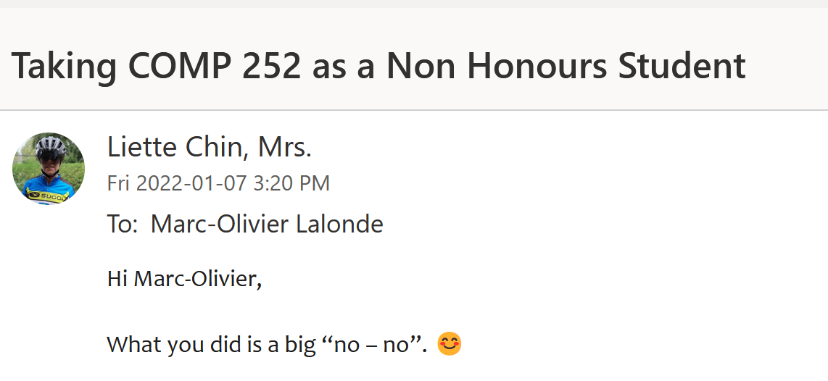
Big no-no

Slide 3
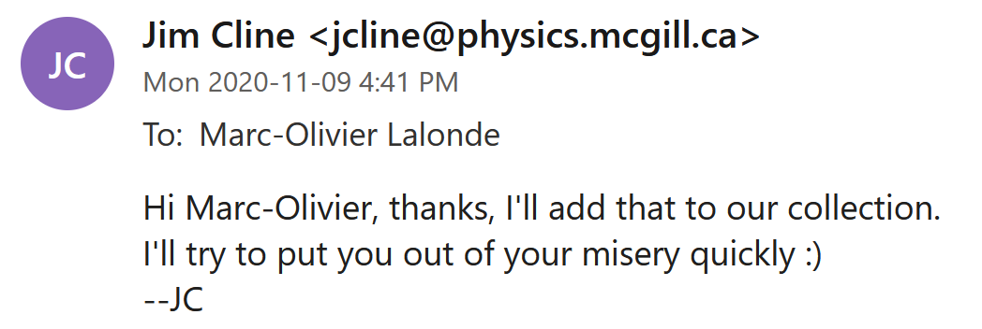
Death by Cline

Slide 4
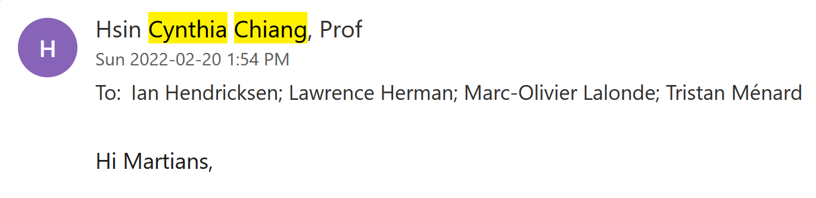
Discrimination

Slide 5
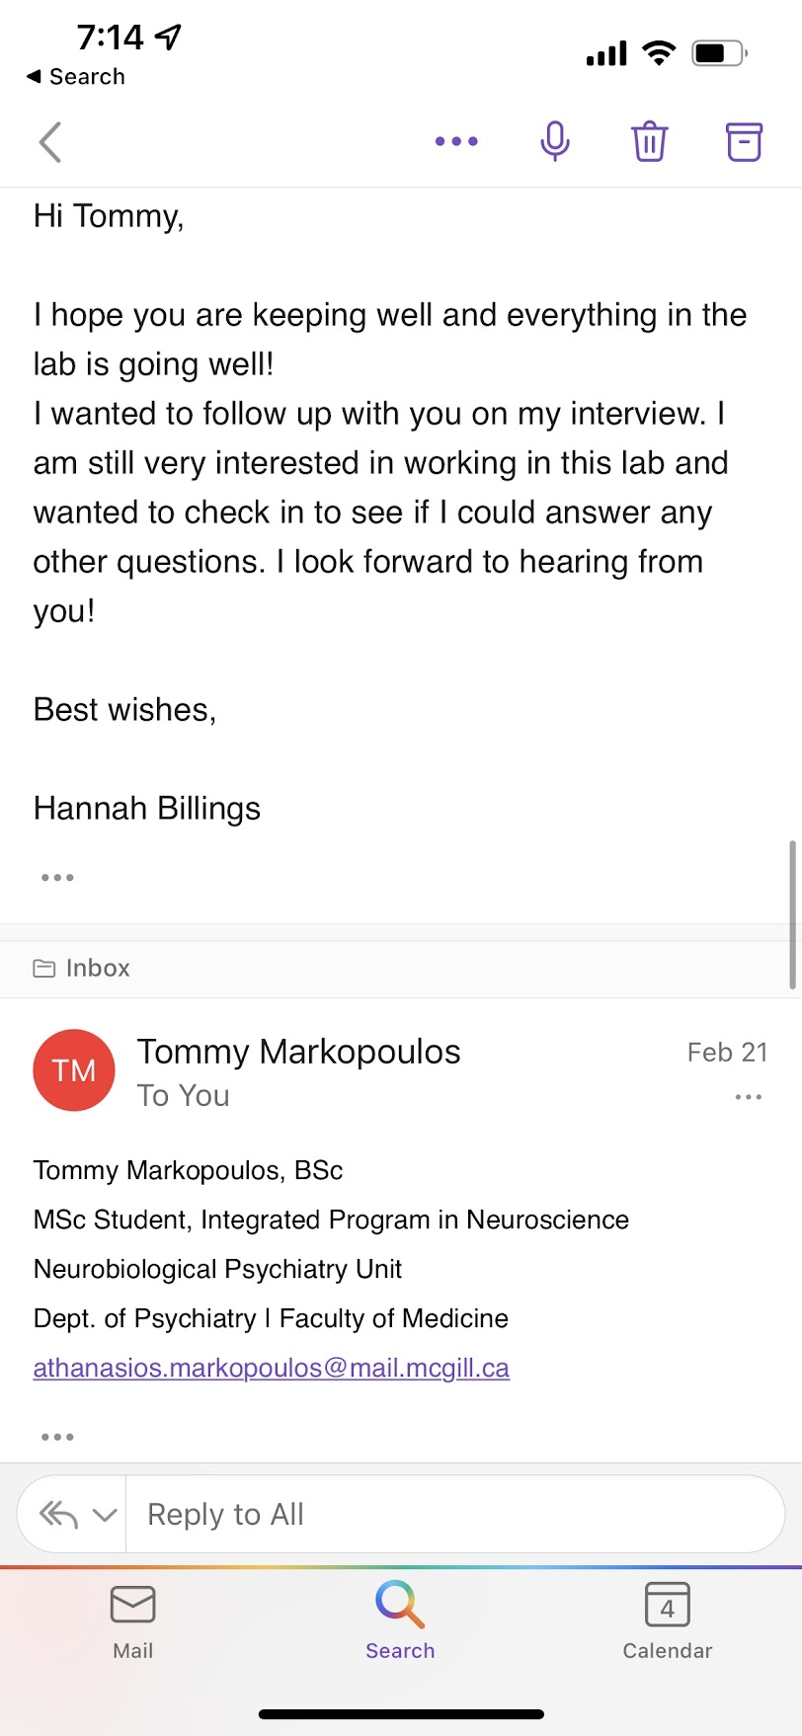
Best Regards

Slide 6
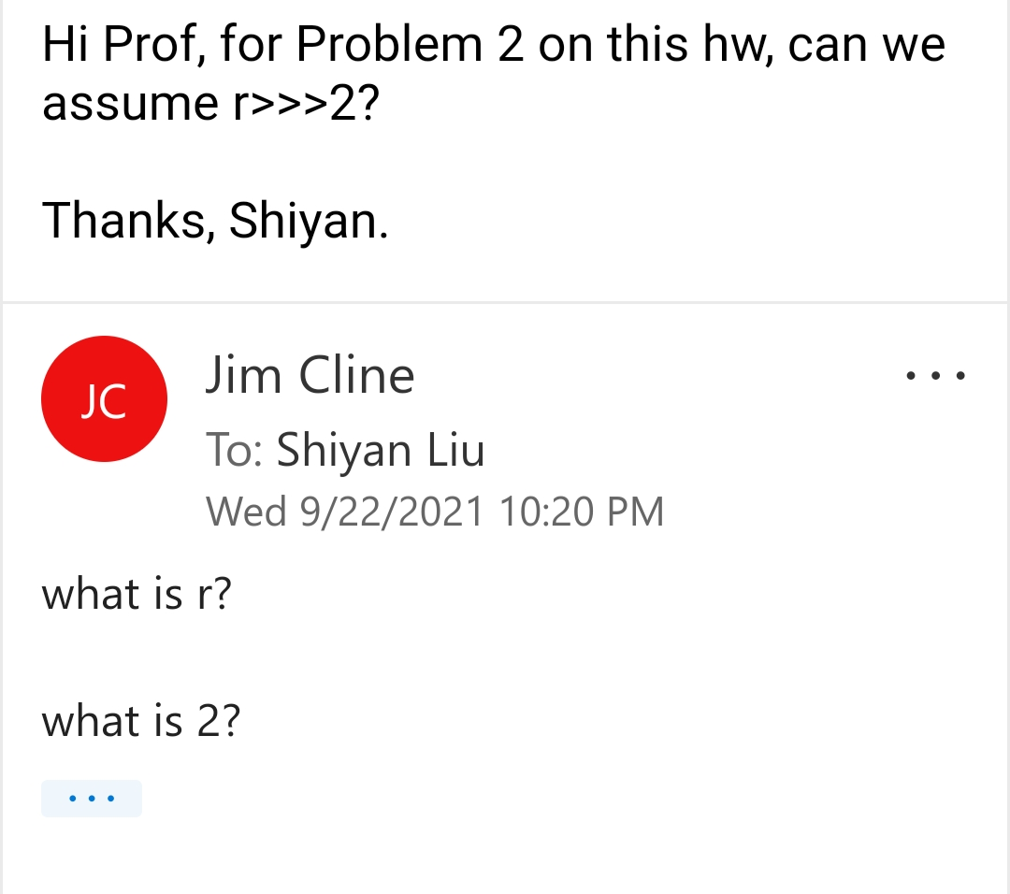
What is 2?

Slide 7
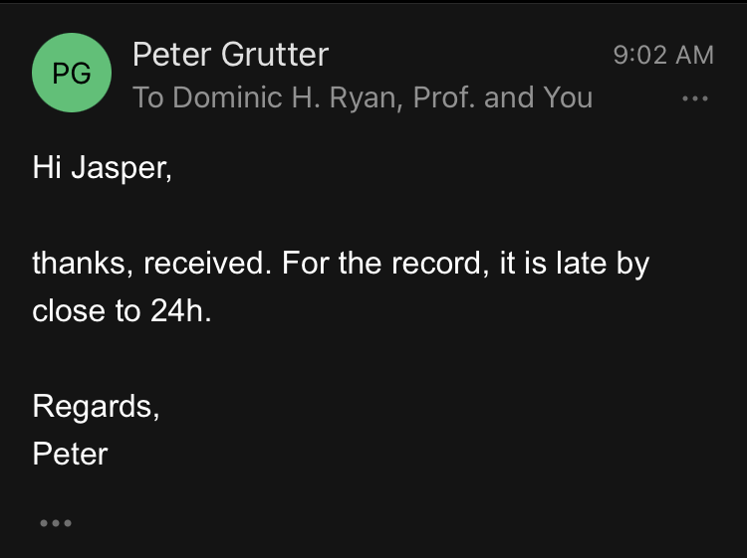
No Shit

Slide 8
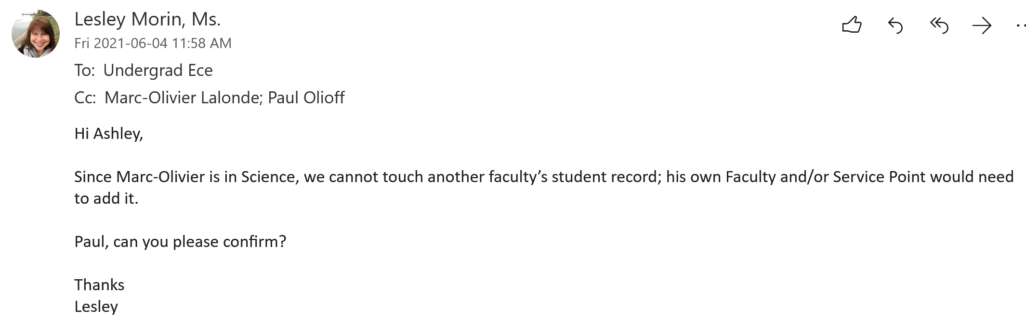
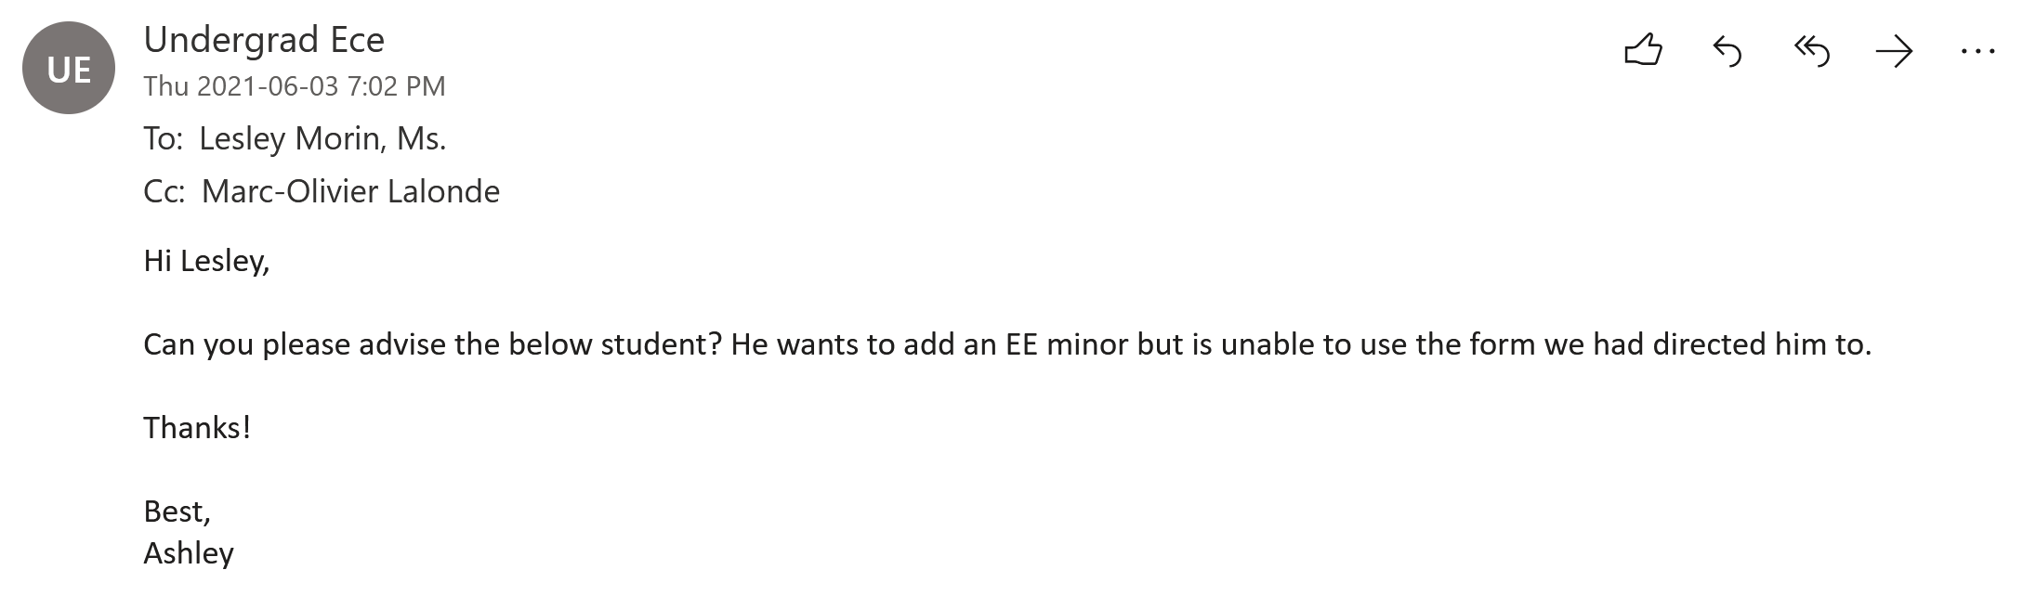
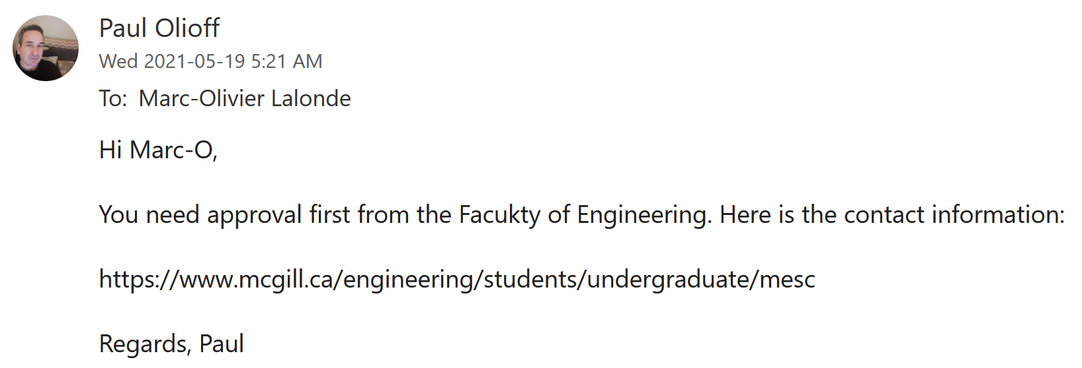
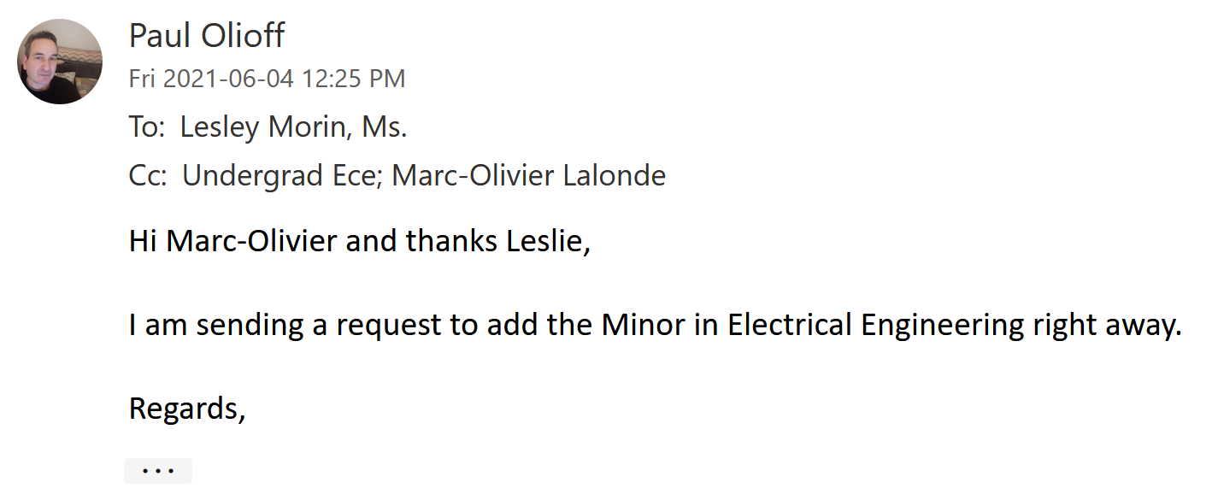
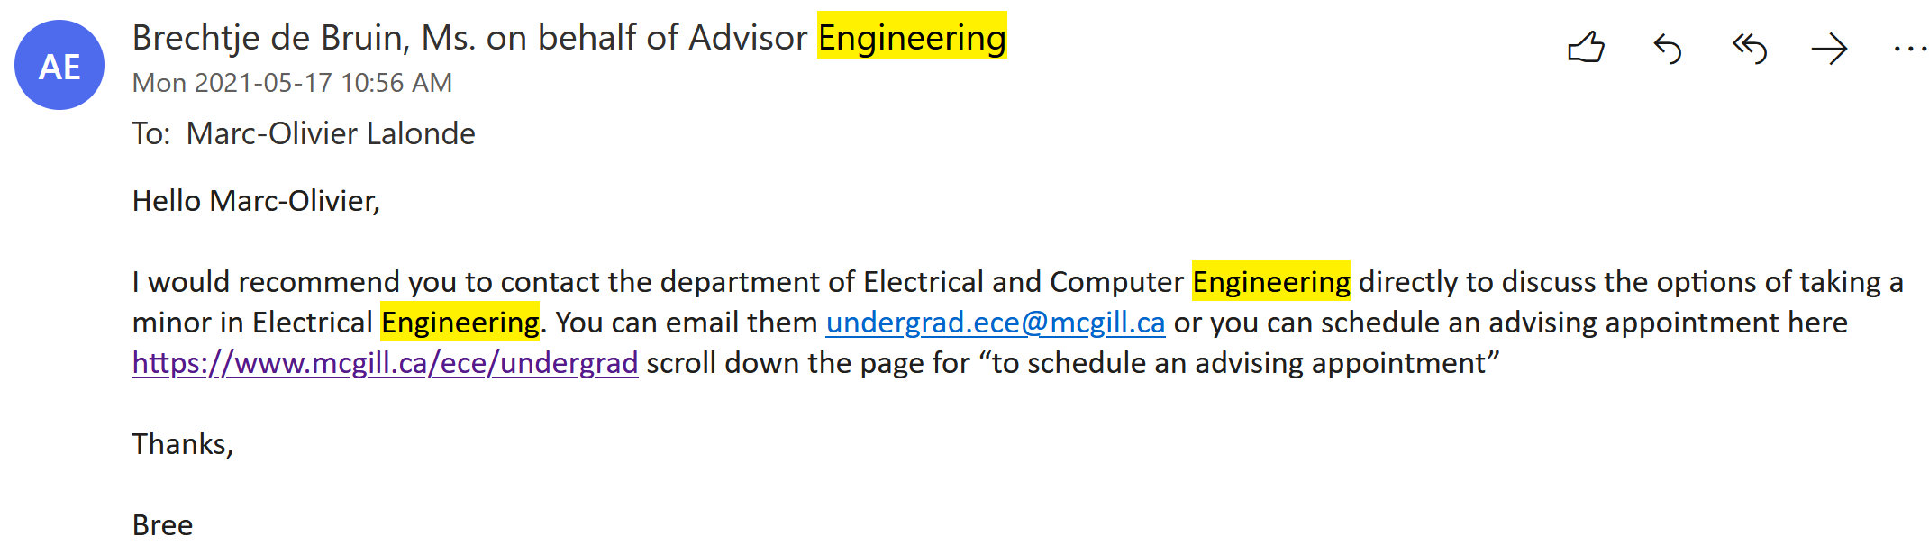
Circle of Death

Slide 9
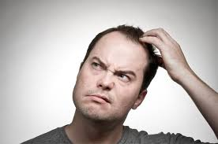


Questions?

Slide 10
References
https://www.google.com/search?q=questions&client=firefox-b-d&channel=trow5&sxsrf=APq-WBs5jJCx_YqDNNc_FiaxkmzBB4_B2g:1646438391479&source=lnms&tbm=isch&sa=X&ved=2ahUKEwissd_71K32AhW2kHIEHSdNDmQQ_AUoAXoECAEQAw&biw=1536&bih=703&dpr=2.5#imgrc=E0G5feEvkEnaWM
https://www.google.com/search?q=confused&client=firefox-b-d&channel=trow5&sxsrf=APq-WBtgNazwtwxzMy0EJmcuAoNd6MYaAA:1646438338532&source=lnms&tbm=isch&sa=X&ved=2ahUKEwjL1r_i1K32AhWdkokEHYLhBe8Q_AUoAXoECAIQAw&biw=1536&bih=703&dpr=2.5#imgrc=ioN4YNDvlJi3lM
https://www.google.com/search?q=confused&client=firefox-b-d&channel=trow5&sxsrf=APq-WBtgNazwtwxzMy0EJmcuAoNd6MYaAA:1646438338532&source=lnms&tbm=isch&sa=X&ved=2ahUKEwjL1r_i1K32AhWdkokEHYLhBe8Q_AUoAXoECAIQAw&biw=1536&bih=703&dpr=2.5#imgrc=xqgK7e30Y9FDYM
Hannah
Jasper
Marc-O
Shiyan

